Slide 1

RISC-V
Pipeline Core
Muhammad Qasim (2023488)
Muhammad Hammad (2023420)

Slide 2
Single Cycle Processor
Overview
Implementation of Fetch Cycle
Implementation of Decode Cycle
Implementation of Execute Cycle
Implementation of Memory Cycle
Implementation of Write Back Cycle
Implementation of Pipeline Top
Pipeline Hazards
Implementation of Hazard Unit
Implementation of Pipeline Top II

Slide 3
Single Cycle Processor

Slide 4
Single Cycle
Definition
Components
A single-cycle processor executes one instruction per clock cycle. All stages of instruction execution occur in the same cycle. Simpler control logic than pipelined processors but slower clock frequency due to long critical path.
Program Counter (PC): Holds address of next instruction.
Instruction Memory: Holds the program; accessed using PC.
Register File: 32 registers for general-purpose storage.
ALU: Performs arithmetic/logical operations.
Data Memory: Stores variables for load/store instructions.
Control Unit: Generates control signals based on opcode.

Slide 5
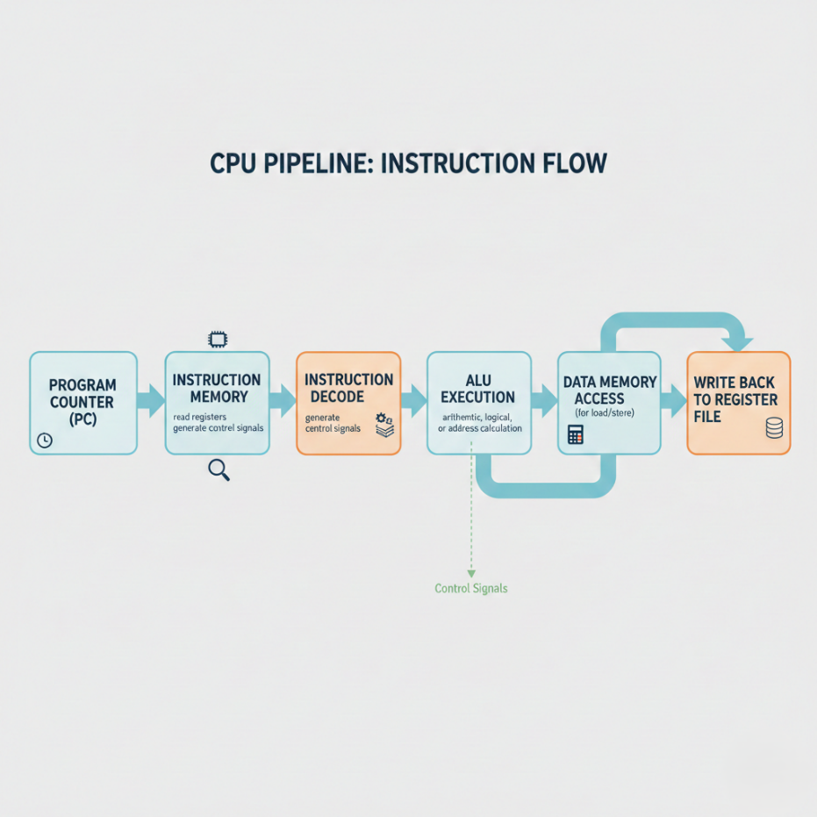
Single Cycle Flow

Slide 6
Overview of RISC-V Pipeline Architecture

Slide 7
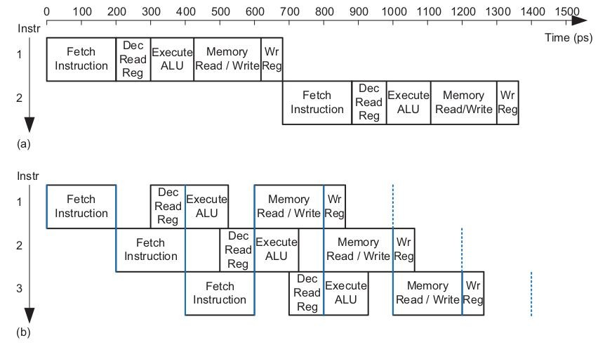
Pipelining
We design a pipelined processor by subdividing the single-cycle processor into five pipeline stages.
Thus, five instructions can execute simultaneously, one in each stage. Because each stage has only one-fifth of the entire logic, the clock frequency is approximately five times faster.

Slide 8

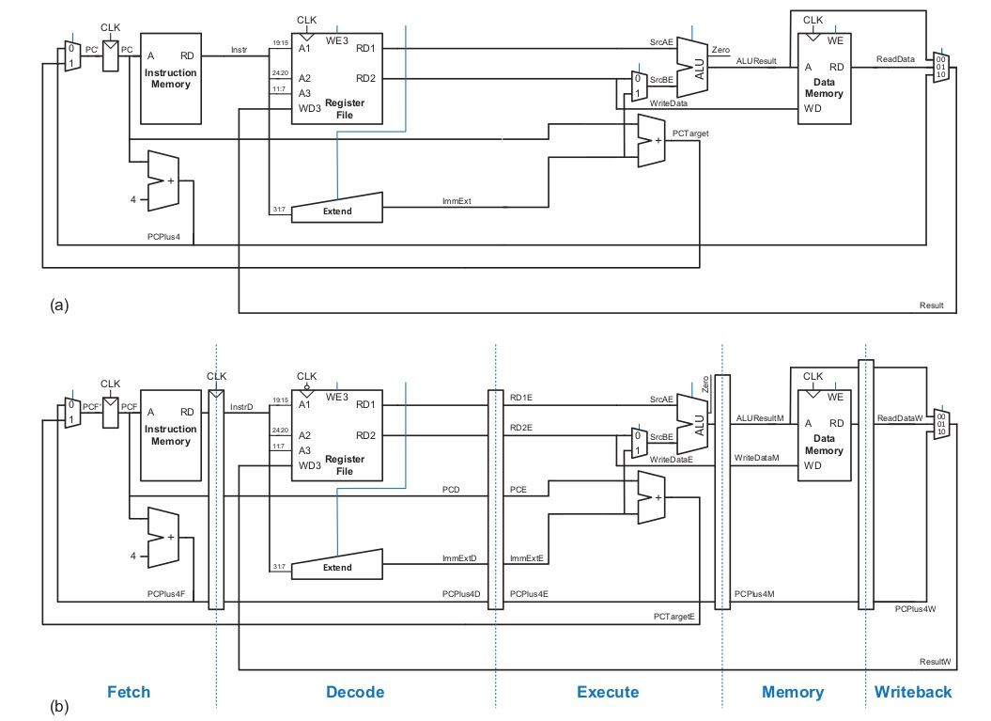
Single Cycle Vs. Pipelining

Slide 9
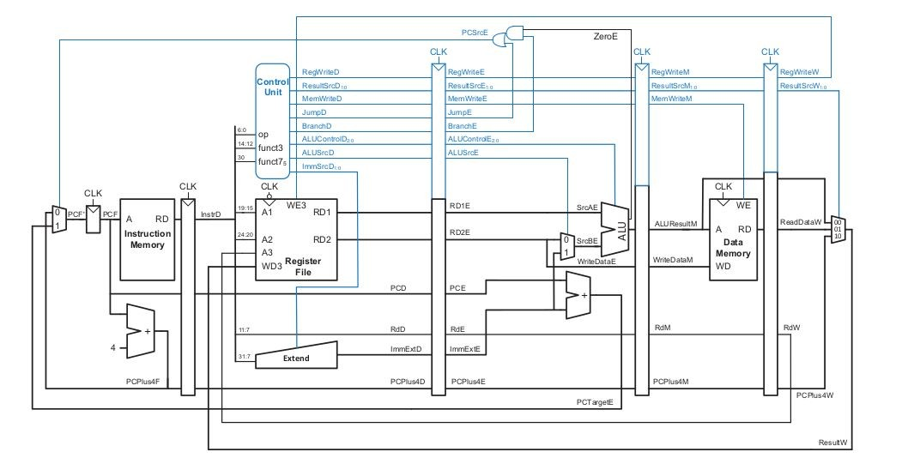
Pipeline Datapath

Slide 10
Implementntion of Fetch Cycle

Slide 11
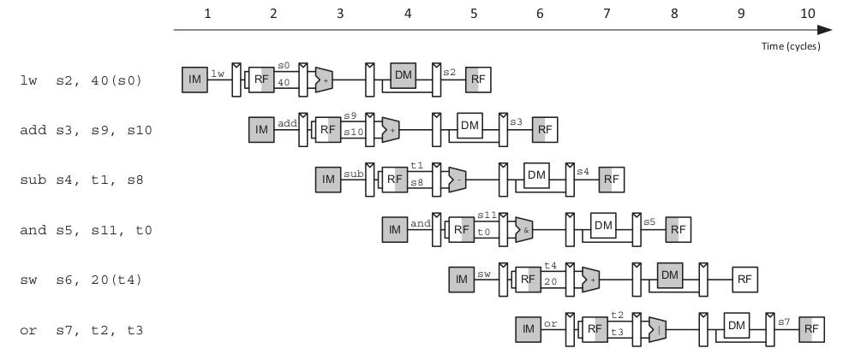
Abstract View of Pipelining

Slide 12
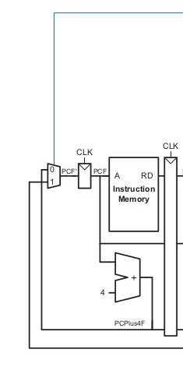
Fetch Cycle Datapath
PCSrcE
Modules to be Integrated:
PC Mux
Program Counter
Adder
Instruction Memory
Fetch Stage Registers
InstrD
PCD
PCPlus4D
PCTargetE

Slide 13
Implementntion of Decode Cycle

Slide 14
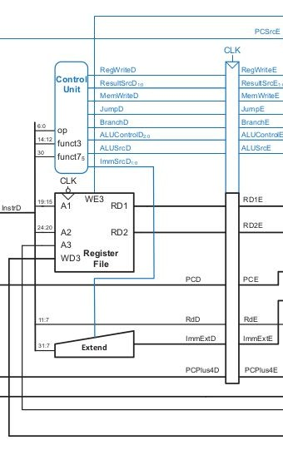
Decode Cycle Datapath
RegWriteW
X
Modules to be Integrated:
Control Unit
Register File
Extender
Decode Stage Registers
InstrD
PCD
PCPlus4D
X RDW
ResultW

Slide 15
Implementntion of Execute Cycle

Slide 16
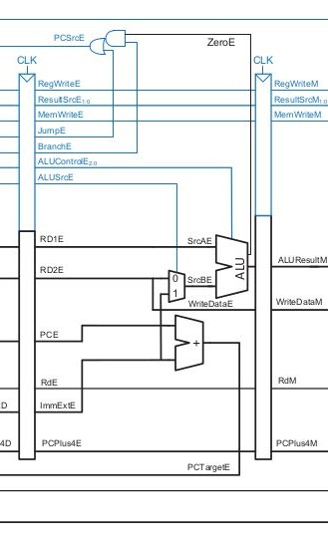
Execute Cycle Datapath
X
Modules to be Integrated:
AND Gate
Mux
Adder
ALU
Execute Stage Registers
X
X

Slide 17
Implementntion of Memory Cycle

Slide 18
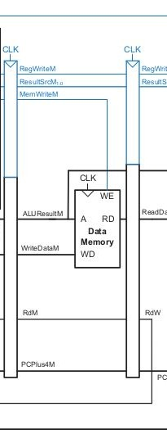
Memory Cycle Datapath
X
Modules to be Integrated:
Data Memory
Memory Stage Registers
X
X

Slide 19
Implementntion of Write Back Cycle

Slide 20
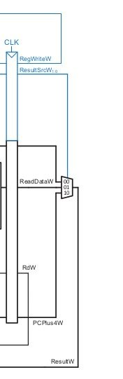
Write Back Cycle Datapath
Modules to be Integrated:
1) Mux

Slide 21
Pipeline Hazards

Slide 22
Pipeline Hazard
Structural Hazard
  Hardware does not support the execution of instruction in same clock cycle.
  Without having Two memories RISC-V pipelining architecture will have structural hazard.
Data Hazard
  Data to be executed is not available.
  May occur when pipeline is stalled.
  Solve by using forwarding or bypassing technique.

Slide 23
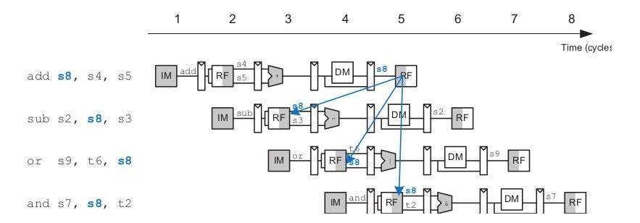
Data Hazard In Pipelining

Slide 24
Solution of Data Hazards
Solving Data Hazards with nops
Solving Data Hazard with Forwarding / Bypassing

Slide 25
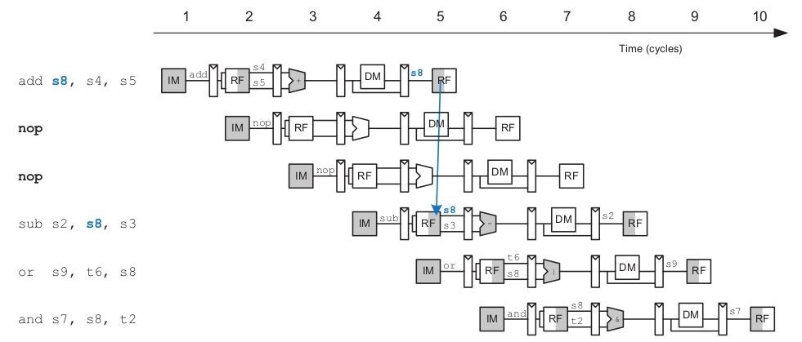
Using Nops

Slide 26
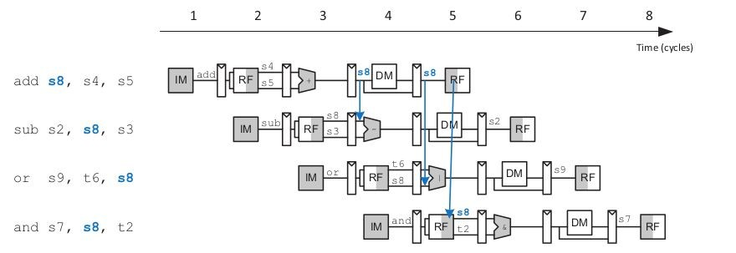
Using Forwarding / Bypassing

Slide 27
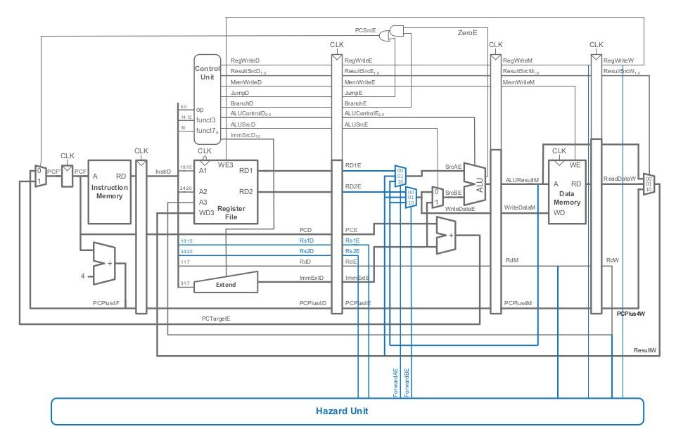
Updated Pipeline Top Architecture

Slide 28
Implementntion of Hazard Unit

Slide 29
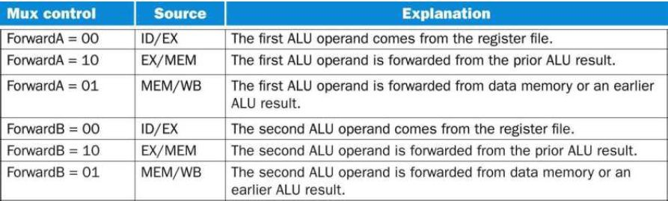
Condition Tnble

Slide 30

Condition for Data Hazard
Memory Stage
if (RegWriteM and (RdM != 0) and (RdM == Rs1E))
ForwardAE = 10
if (RegWriteM and (RdM != 0) and (RdM == Rs2E)) ForwardBE = 10
WriteBack Stage
if (RegWriteW and (RdW != 0) and (RdW == Rs1E))
ForwardAE = 01
if (RegWriteW and (RdW != 0) and (RdW == Rs2E)) ForwardBE = 01
ForwardAE ForwardBE
RegWriteM
RdW RegWriteW
Rs2E Rs1E
RdM

Slide 31
Implementntion of Pipeline Top II

Slide 32
Updated Pipeline Top Architecture

Slide 33
Thank You

